Slide 1
Graphic design
fundamentals
A design intro for visual journalists

Slide 2
Graphics/graphic design =
visual communications
Graphic design is deliberate and considered.
It is designed.

Slide 3
Four basic principles of design:
- Contrast
- Repetition
- Alignment
- Proximity

Slide 4
Contrast
Use contrast to add visual interest to your work
- Contrast is created when two elements are different
- Grabs a reader's attention
- Creates hierarchy among elements
- Direct a reader's eye

Slide 5
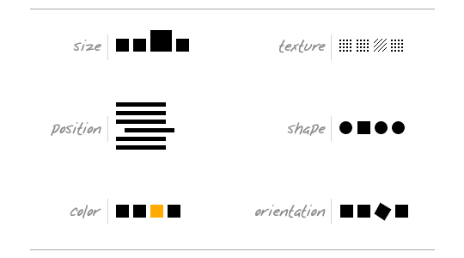
Contrast
Contrast can be used in many ways.

Slide 6
Contrast
A few rules.
- Elements should be the same or very different.
- All colors and elements must match and feel organic.
- Too many contrasting elements is bad design.

Slide 7
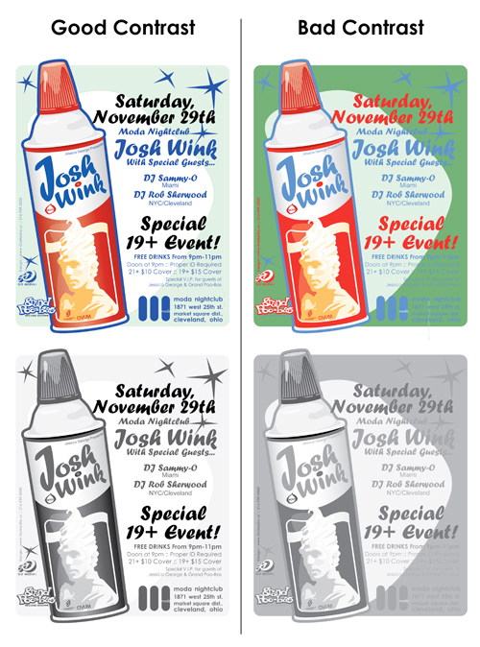

Slide 8
prox imity
Use to group related elements
- Move related elements together so they are seen as one unit/group.
- Do not group unrelated items-- move them apart.
- Useful to reduce the number of elements on a page.

Slide 9
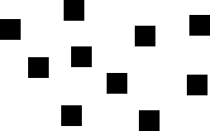
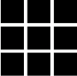
Proximity: Physical closeness implies a relationship.

Slide 10
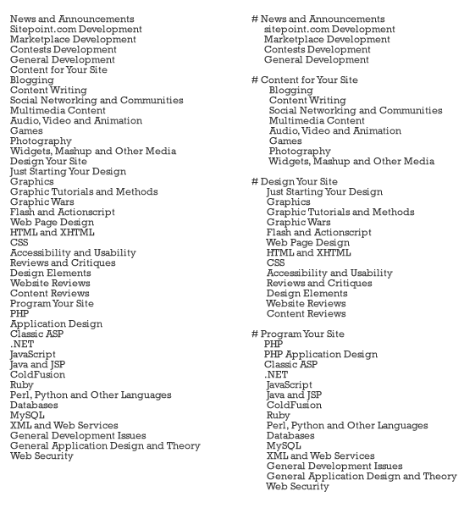

Slide 11
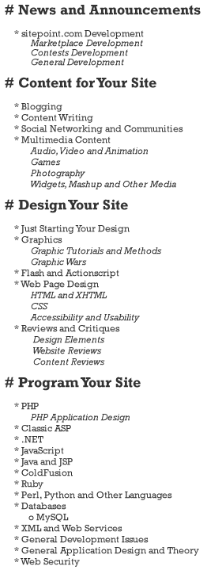

Slide 12
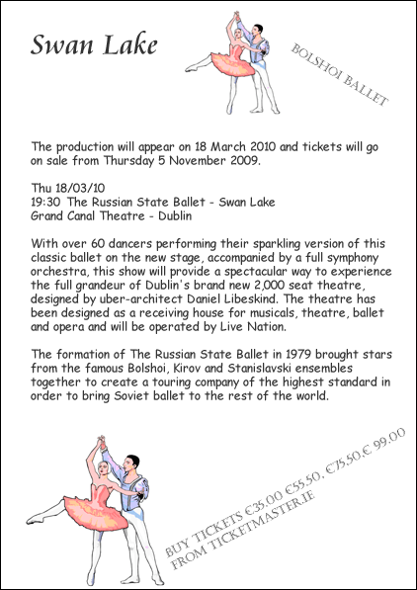
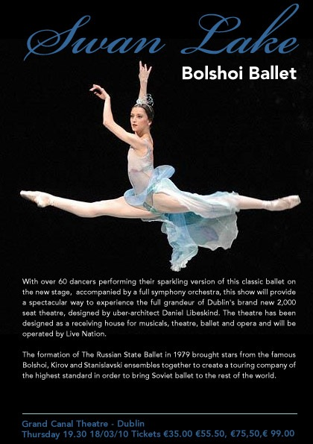
Credit: Site Point

Slide 13
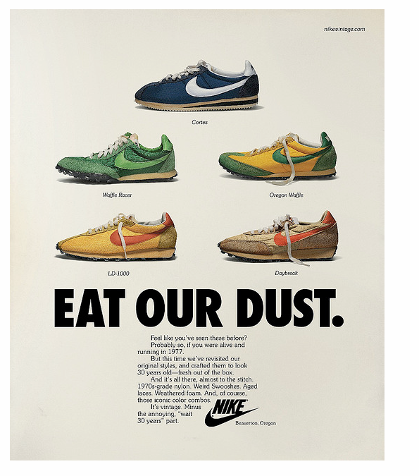
Use proximity to reduce the number of elements on a page and imply cohesion.

Slide 14
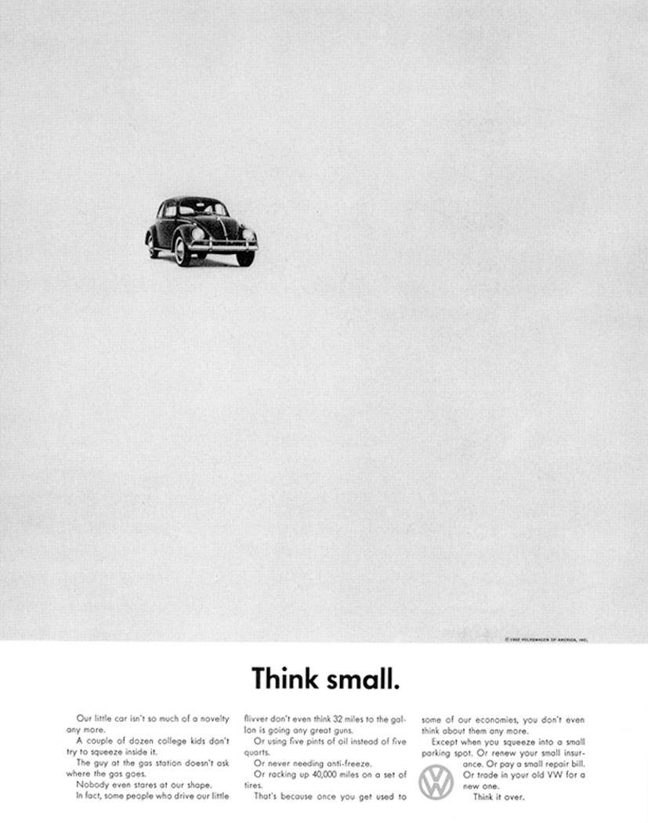
Don’t be afraid of white space.

Slide 15
Alignment
Use to create unity between elements and organize the page.
- Nothing should be placed on the page arbitrarily.
- Every item should have a visual connection with something else on the page.

Slide 16
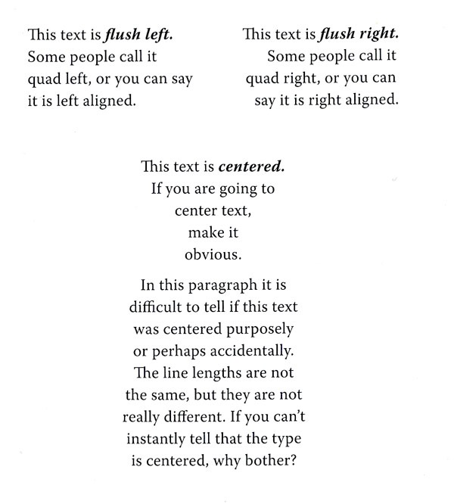
Alignment

Slide 17
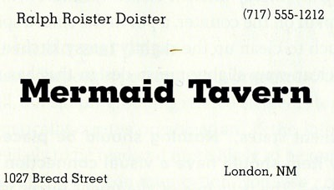
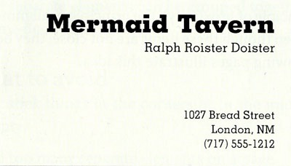

Slide 18
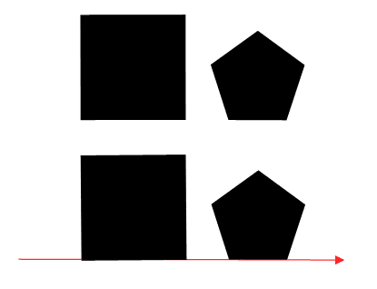

Slide 19
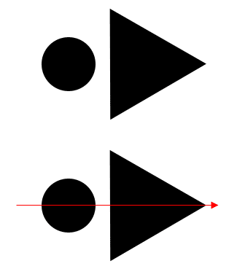

Slide 20
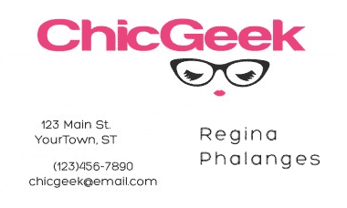

Slide 21
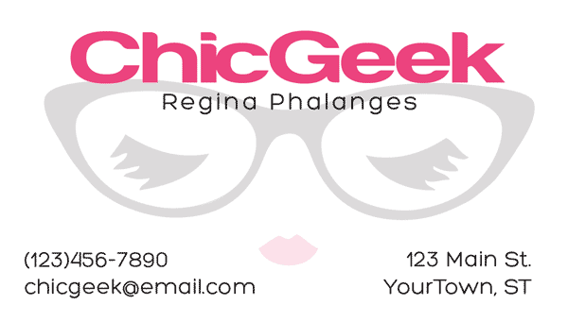

Slide 22
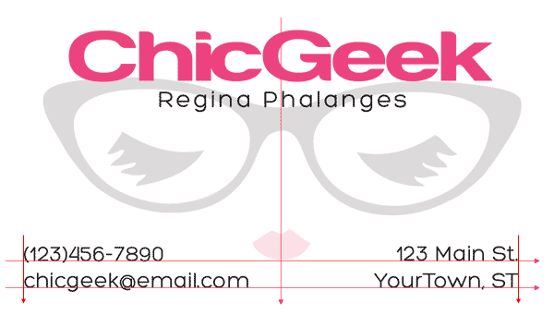
Credit: PrintWand

Slide 23
Alignment
A few rules.
- Be conscious of where you place elements on a page.
- Every element should be aligned with other elements.
- Avoid using more than one text alignment per page.
- Do not use centered text except where appropriate.

Slide 24
Repetition
Use to create consistency (unity) and visual interest.
- Repeat aspects of the design throughout the entire piece.
- Repeat a bold font, a line, a bullet, color or other design element.
- Use to tie together elements on a page or to create unify in a multipage document.

Slide 25
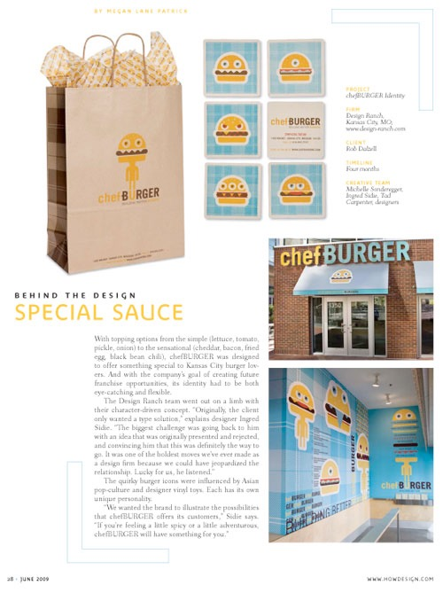
Use repetition to tie together physical elements with your brand:

Slide 26
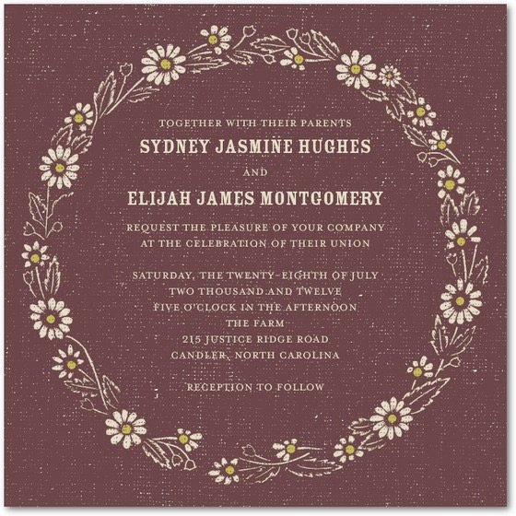
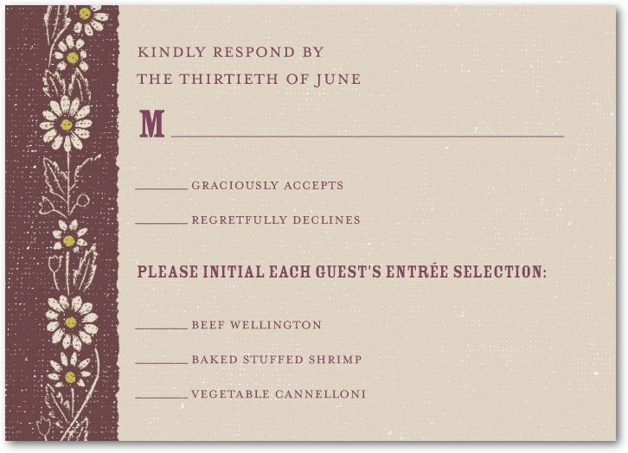
Use repetition to tie together elements of a package:

Slide 27
Unity
To make all elements on the page appear to be unified, connected and interrelated, there needs to be some visual tie between the separate elements. Accomplish unity by applying design fundamentals: contrast, repetition, alignment and proximity.
What is unity? (video)

Slide 28
We will discuss type in 2 main categories
Serif
Sans-serif

Slide 29
Serif 18-point
Serif 18-point italic
Serif 18-point bold
Sans serif 24-point
Sans serif 24-point italic
Sans serif 24-point bold
Script type
Display / decorative type

Slide 30
Serif fonts
Baskerville
Bodoni
Merriweather
Georgia
Times
Garamond
M

Slide 31
Sans-serif fonts
Helvetica
Verdana
Gill Sans
Century Gothic
Arial
Lato
M

Slide 32
Helvetica is one of the most popular fonts in the world.
“The meaning is in the content of the type and not the typeface. And that is why we loved Helvetica.”
Wim Crouwel (Dutch graphic designer)
20 Famous logos made with helvetica
Helvetica documentary

Slide 33
Leading is the vertical space between lines of type.
An example of a line with
tight leading
An example of a line with
regular leading
An example of a line with
loose leading

Slide 34
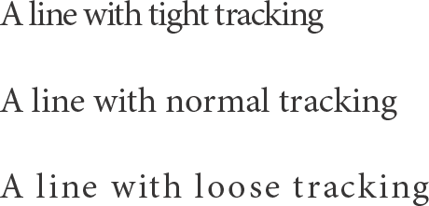
Tracking is the horizontal space between letters.

Slide 35
A few guidelines
- Don’t use too many fonts. 1-2 is a good rule of thumb.
- Type should be consistent and help create unity.
- Utilize bold, italic, weights, sizes and colors to create contrast and interest (but not too many-- repeat elements).
- Use pull quotes, drop caps, bullets, lines and other elements to create interest and organize information.

Slide 36
Sketching is a graphic design fundamental.
Don’t overthink it.

Slide 37
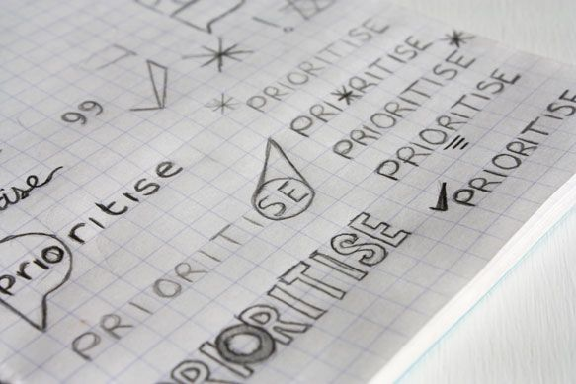

Slide 38
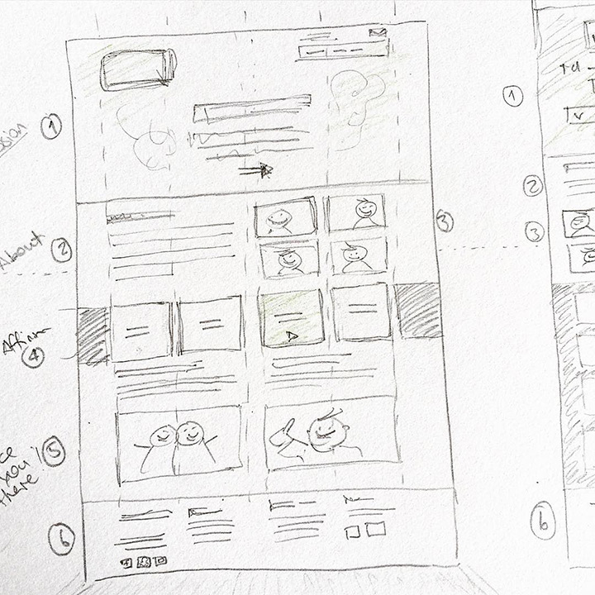

Slide 39
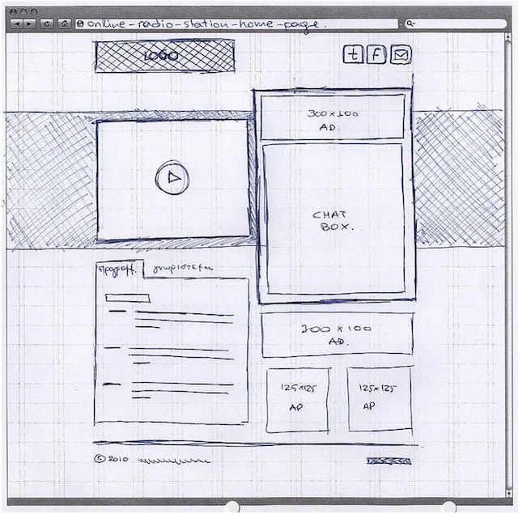

Slide 40
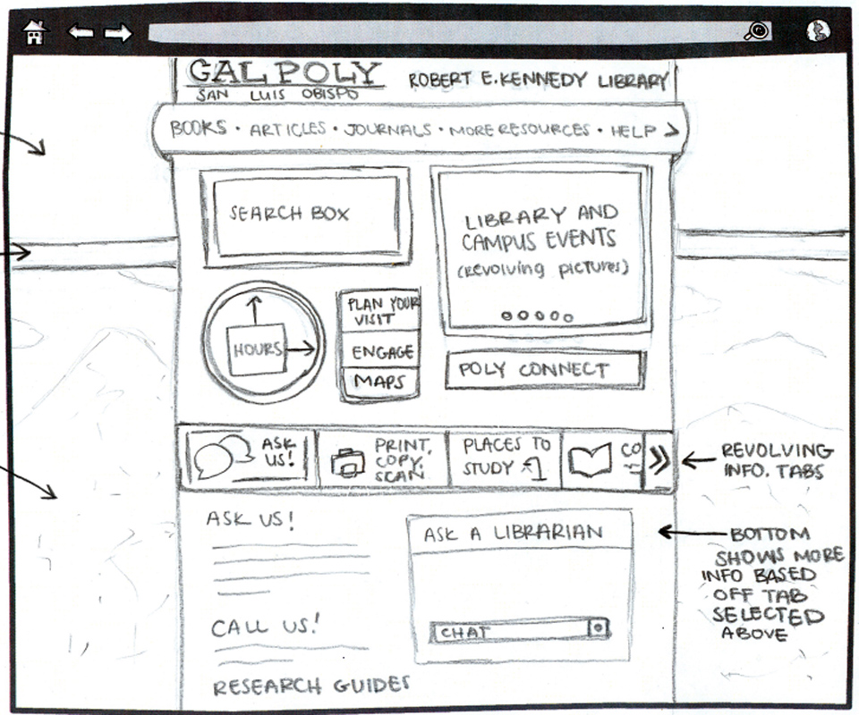

Slide 41
Let’s look at some modern(ish) graphic design examples and try to answer a few questions.

Slide 42
When you’re designing, think about...
How is contrast used in this design?
What elements are repeated?
What is the alignment? What effect does it create?
How is proximity used in the design?
How is unity accomplished in this design?
What is the overall concept / idea behind this design?

